Slide 1
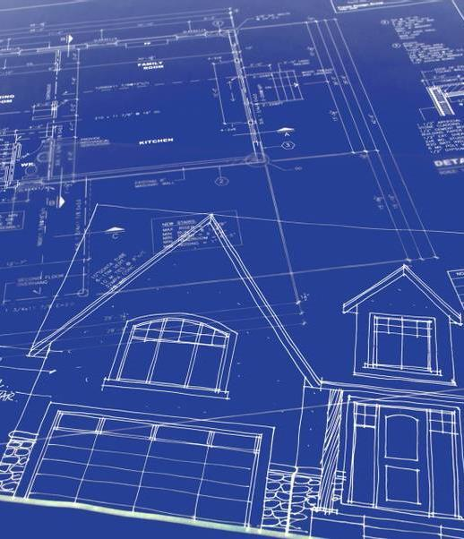
Facilities Exploration Workshop
What has been done so far?

Slide 2
Background
Current Facility Building Improvements
246 Church Street purchased in 1999 for $350,000. 50 congregants at that time.
Use permit from City of Grass Valley allowing use as a church after used as a mortuary from 1925-1999.
Occupany conditions included use of off street parking at Bell Hill School.
Many improvement and repairs over the last 23 years, at a total cost of about $120,000
Repairs have included: new front and rear entry doors, remodeled bathrooms, accessible ramps, roof replacement, new windows, new heating and cooling system, new signage and landscaping.

Slide 3
More Background
Financial
The mortgage on the property was fully paid off in Febrary 2020.
The current operating budget is $267,000.
A current real estate appraisal of the property is $764,000.

Slide 4
Facilities Exploration Committee (FEC) work in 2021-2022
Background Building Condition
FEC was formed in 2019 by the Board of Trustees, but work put on hold because of pandemic.
FEC re-started “explorations” in September 2021 with regular meetings and a schedule of “tasks”.
Evaluated condition of building with an independent commercial building inspector.
Prepared drawings of the existing building and property with field measurement survey.
Existing building includes a total of 5,464 square feet in the interior area.

Slide 5
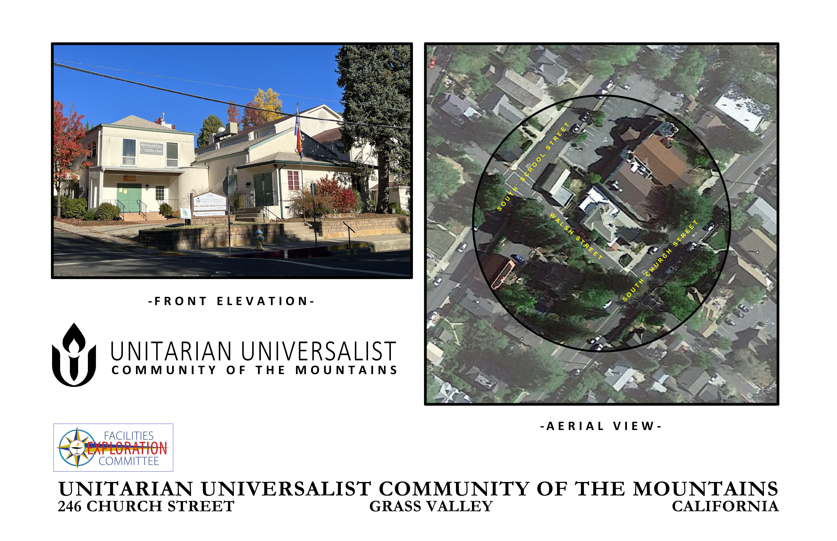
Facilities Exploration Committee (FEC) work in 2021-2022
Our Current Facility

Slide 6
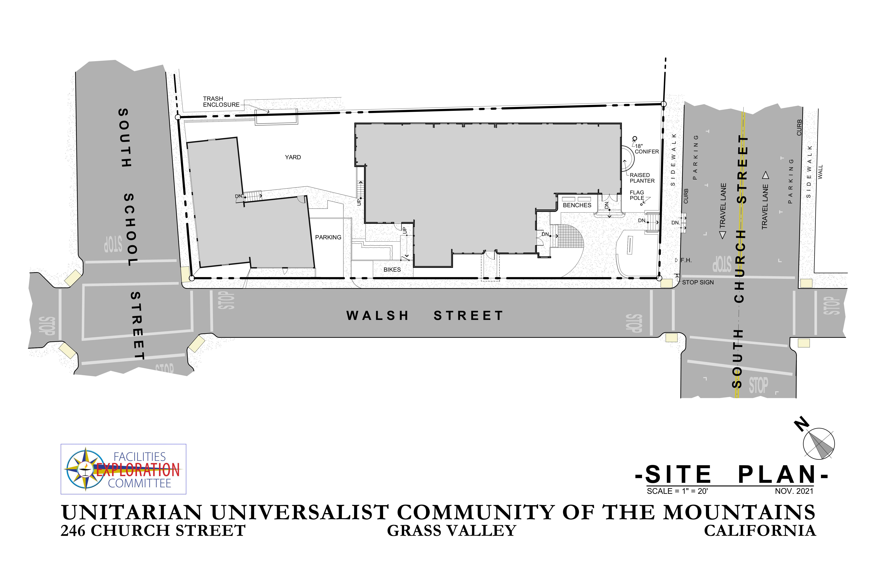
Site Plan

Slide 7
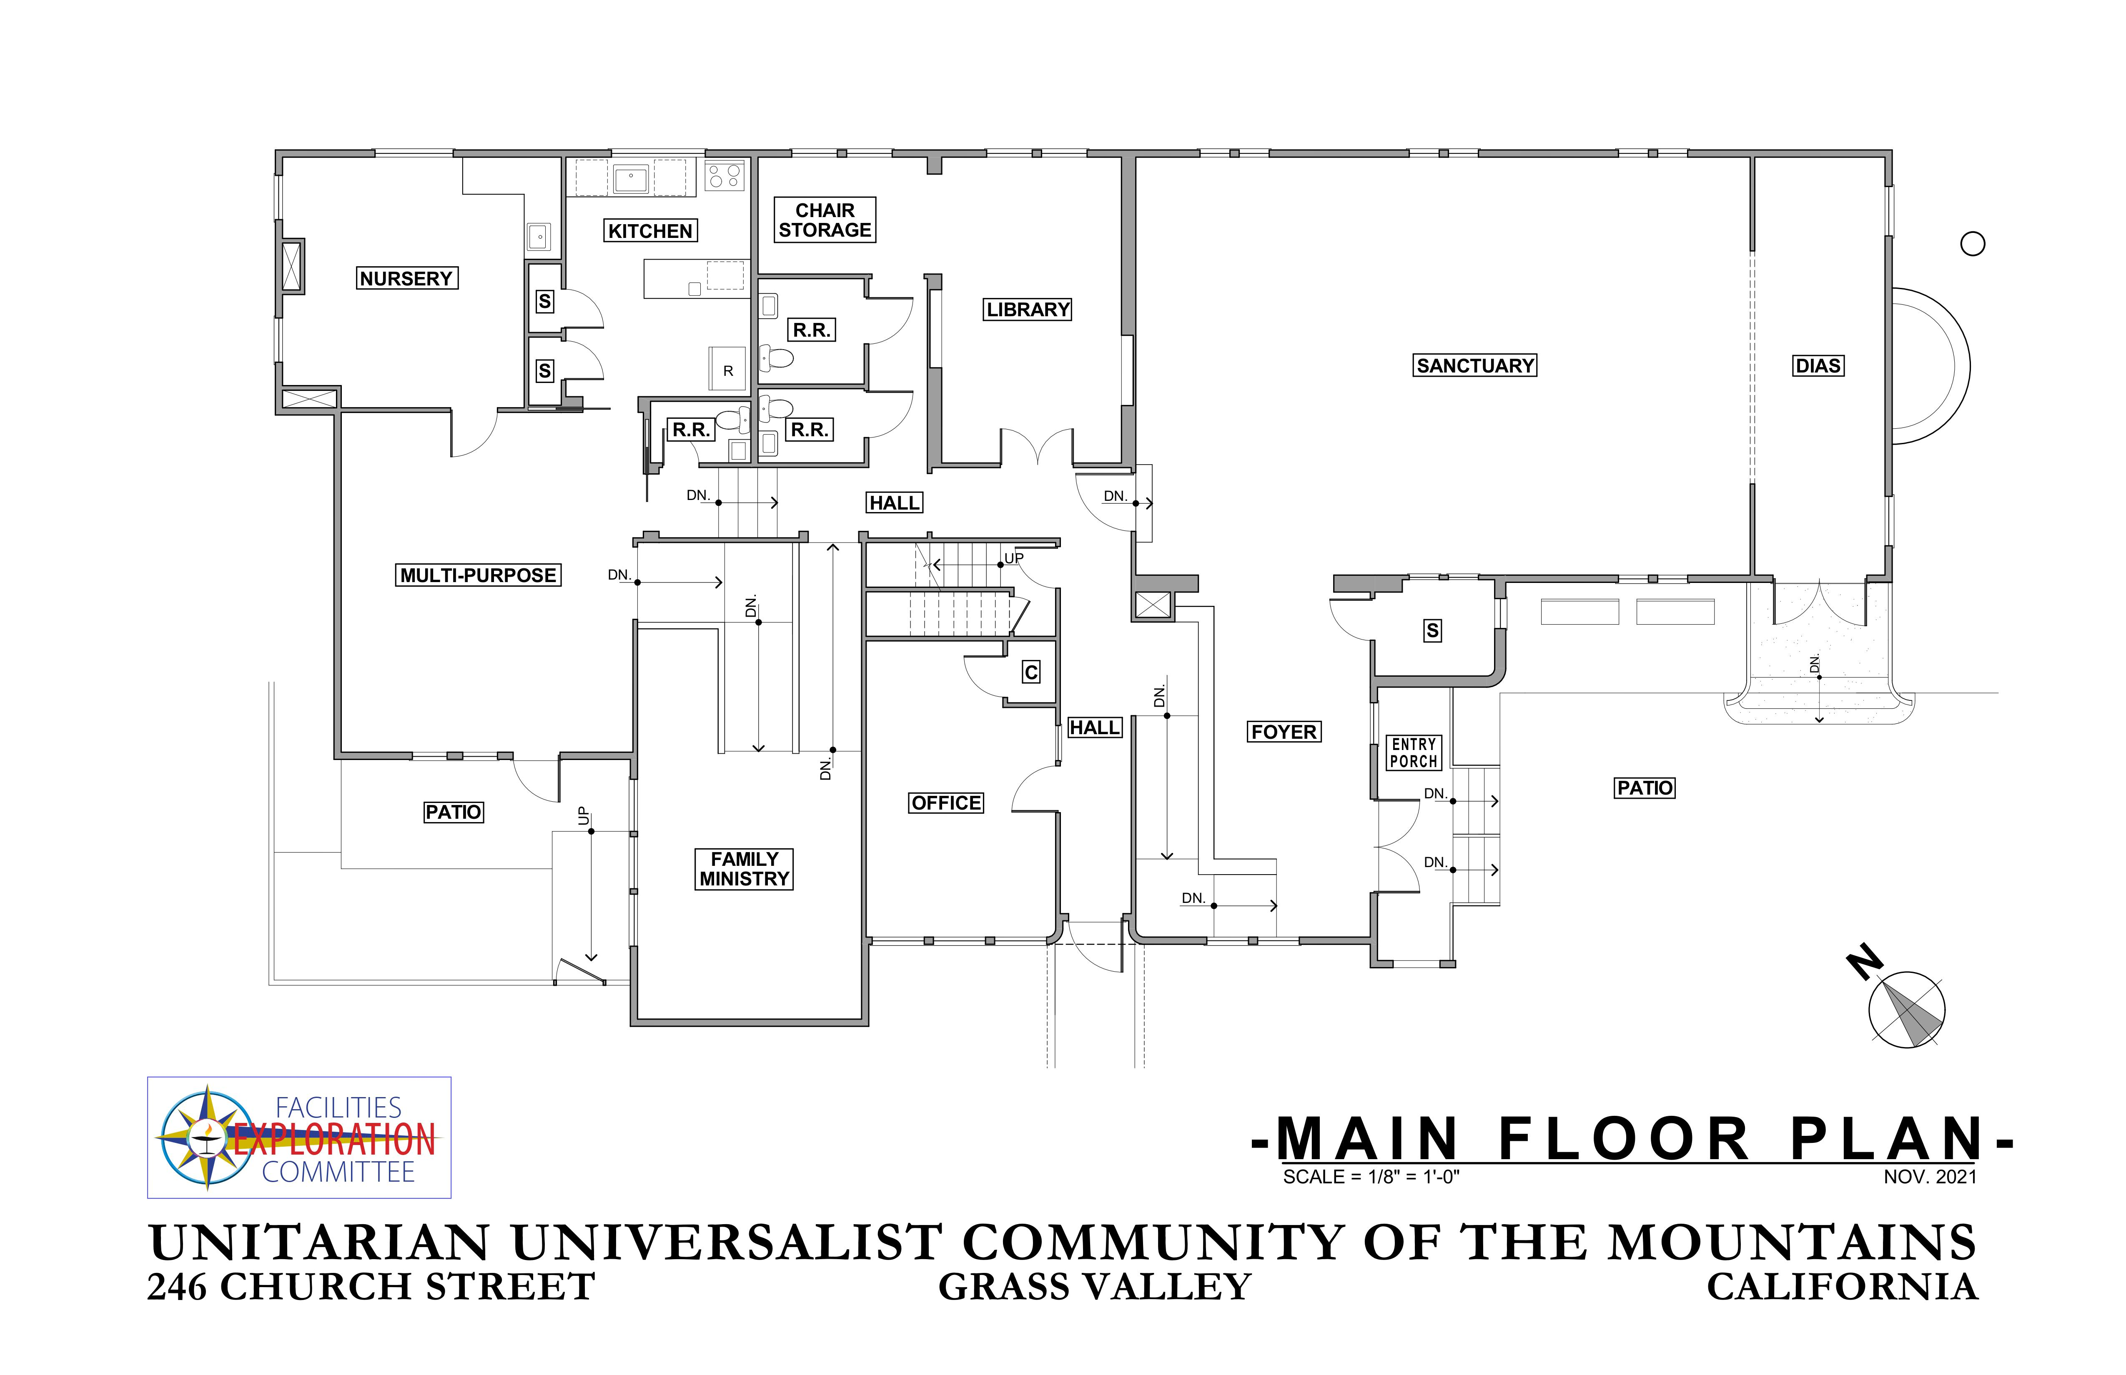
Floor Plan

Slide 8
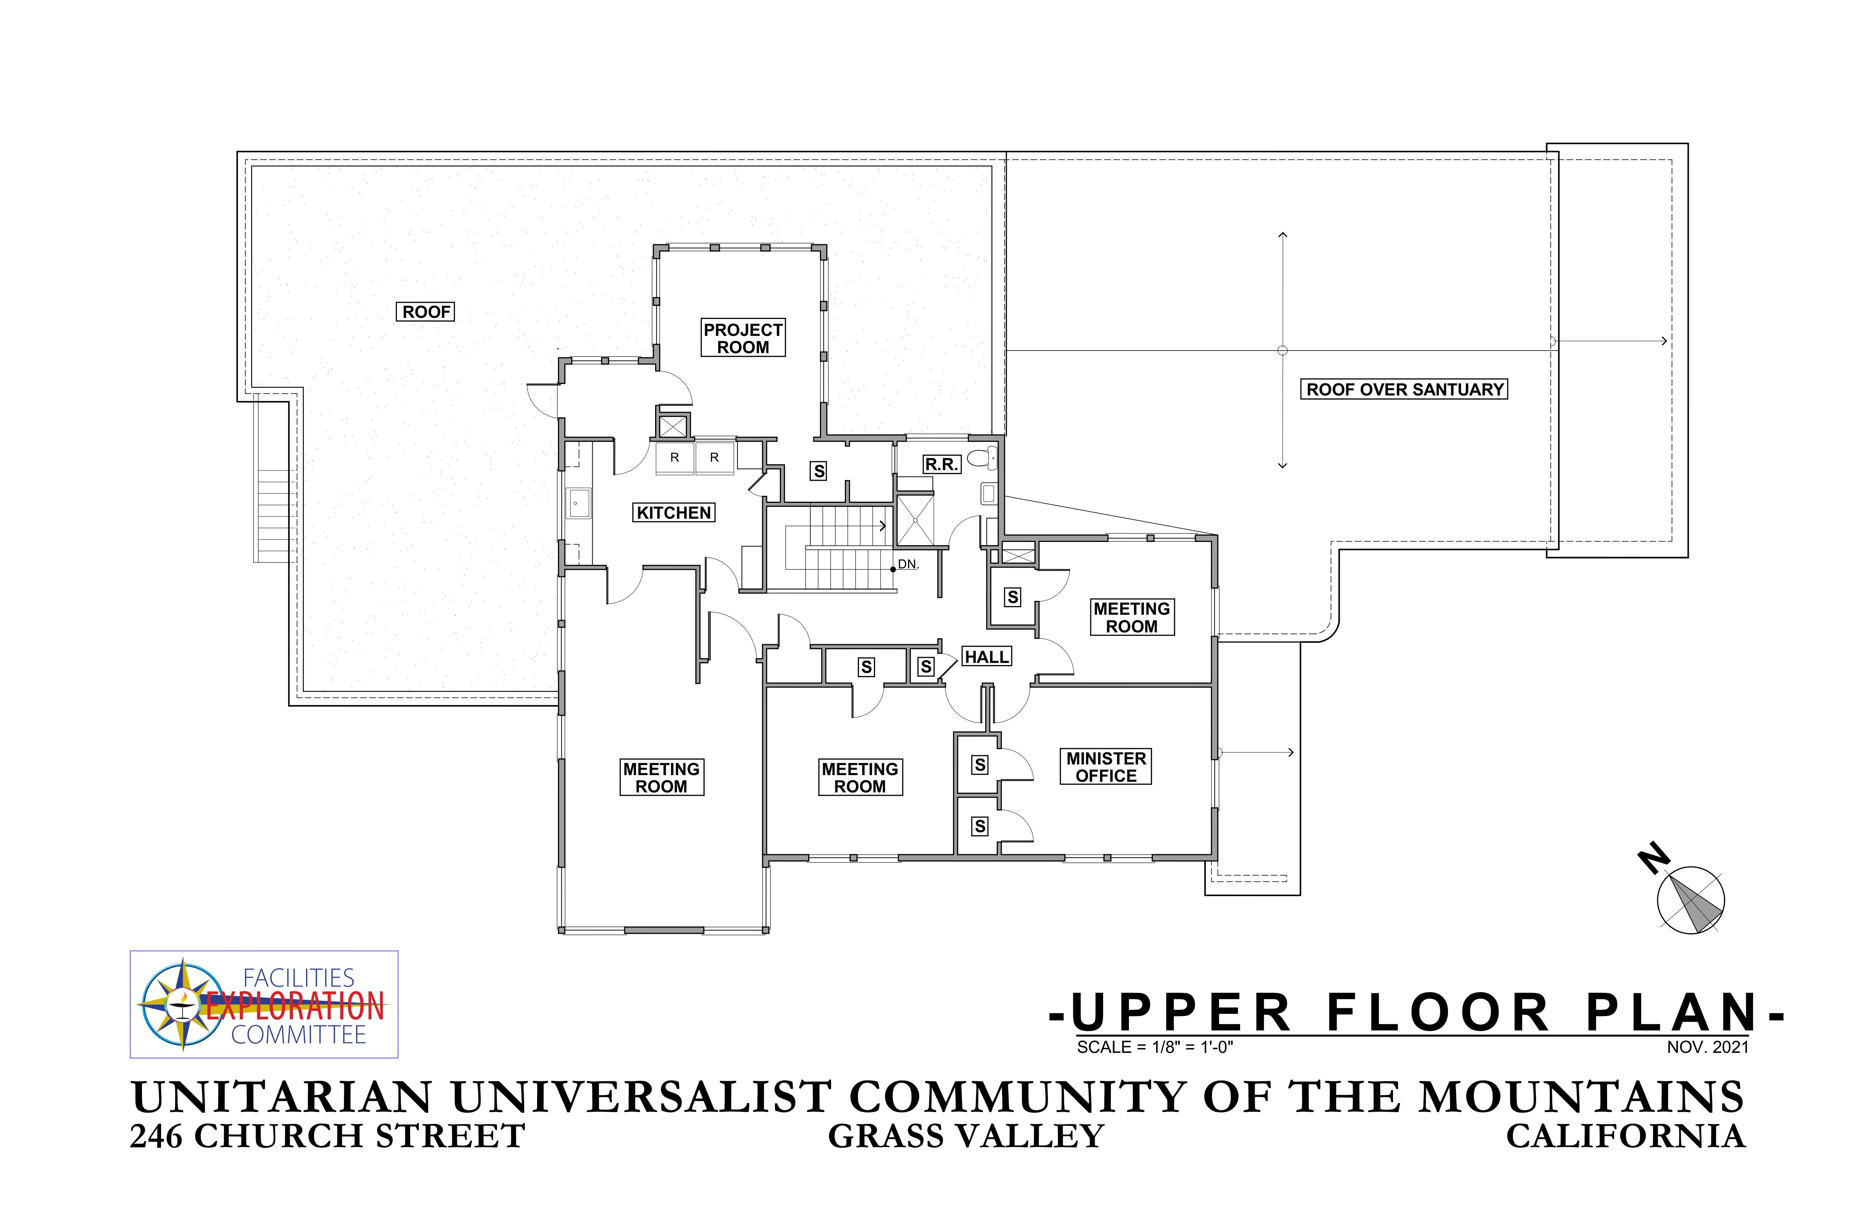
Floor Plan

Slide 9
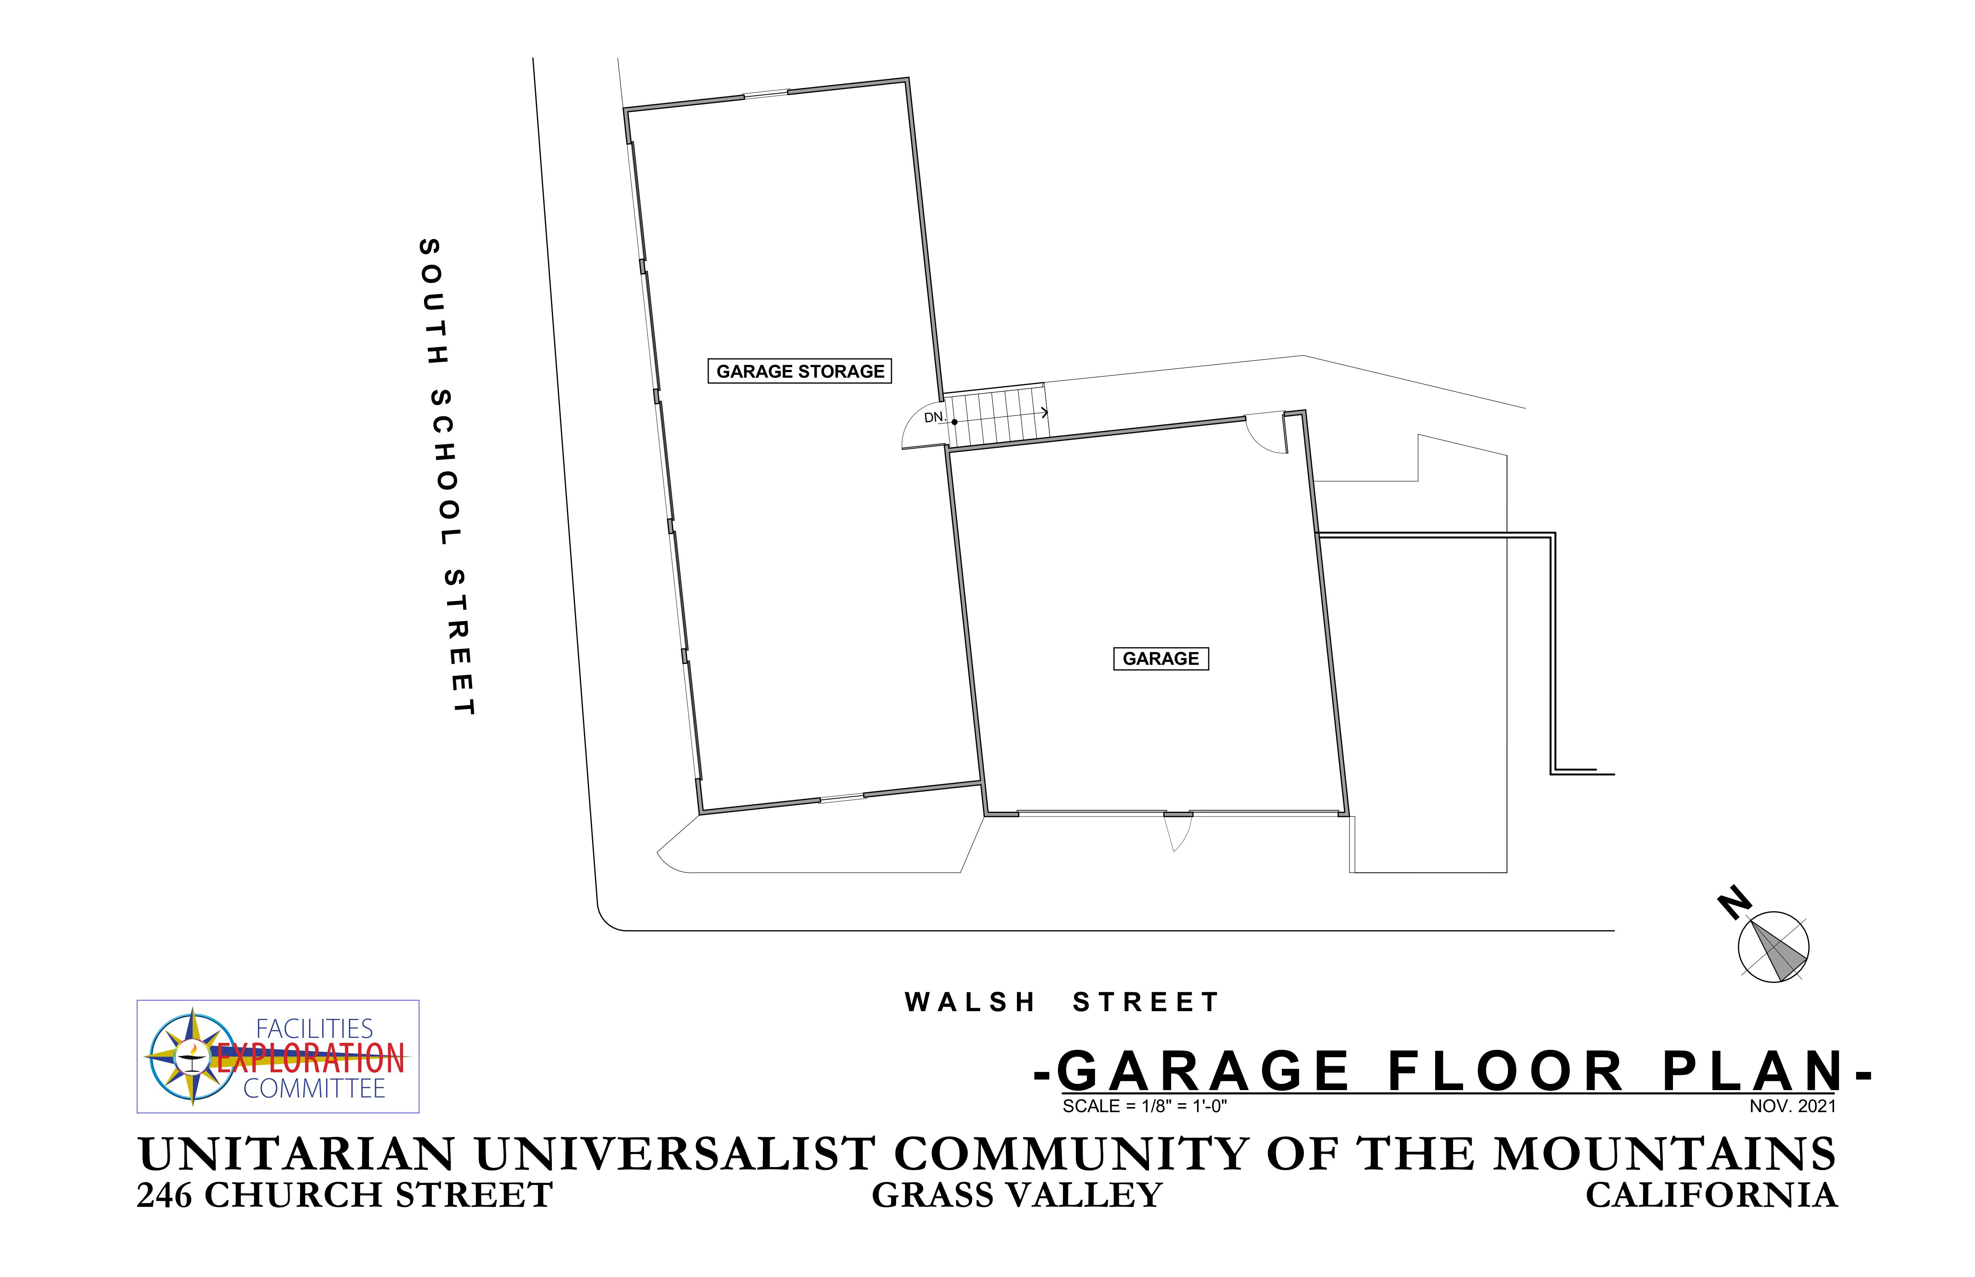
Floor Plan

Slide 10
Work in 2021-2022 continued
Focus Group Assessment:
Prepared questionnaire and gathered detailed input from Worship, Family Ministry, Music, Administration, Stewardship and Building & Grounds Teams.
All teams identified the need for additional interior and exterior spaces to support current and future programs.

Slide 11
More 2021-2022 work
Congregational Assessment
Sent questionnaire to all congregation members and friends, with 80 responses.
FEC prepared detailed analysis and evaluation of all the responses and comments.
Strong preferences registered for ‘welcoming facility’, ‘green sanctuary’, larger space to accommodate everyone, complete accessibility, more space for youth and family programs and more outdoor space.
Two-thirds preferred “relocation” over “remodeling” for long term.
11 people expressed reservations about the costs involved in these options.

Slide 12
And even more 2021-2022 Activity
Options for building remodel
Held meetings with City of Grass Valley Chief Planner, Building Inspector and Fire Marshall to identify issues and “code-compliance” items.
Prepared conceptual sketch study for how current facility could be expanded for more building space and second floor accessibility.

Slide 13
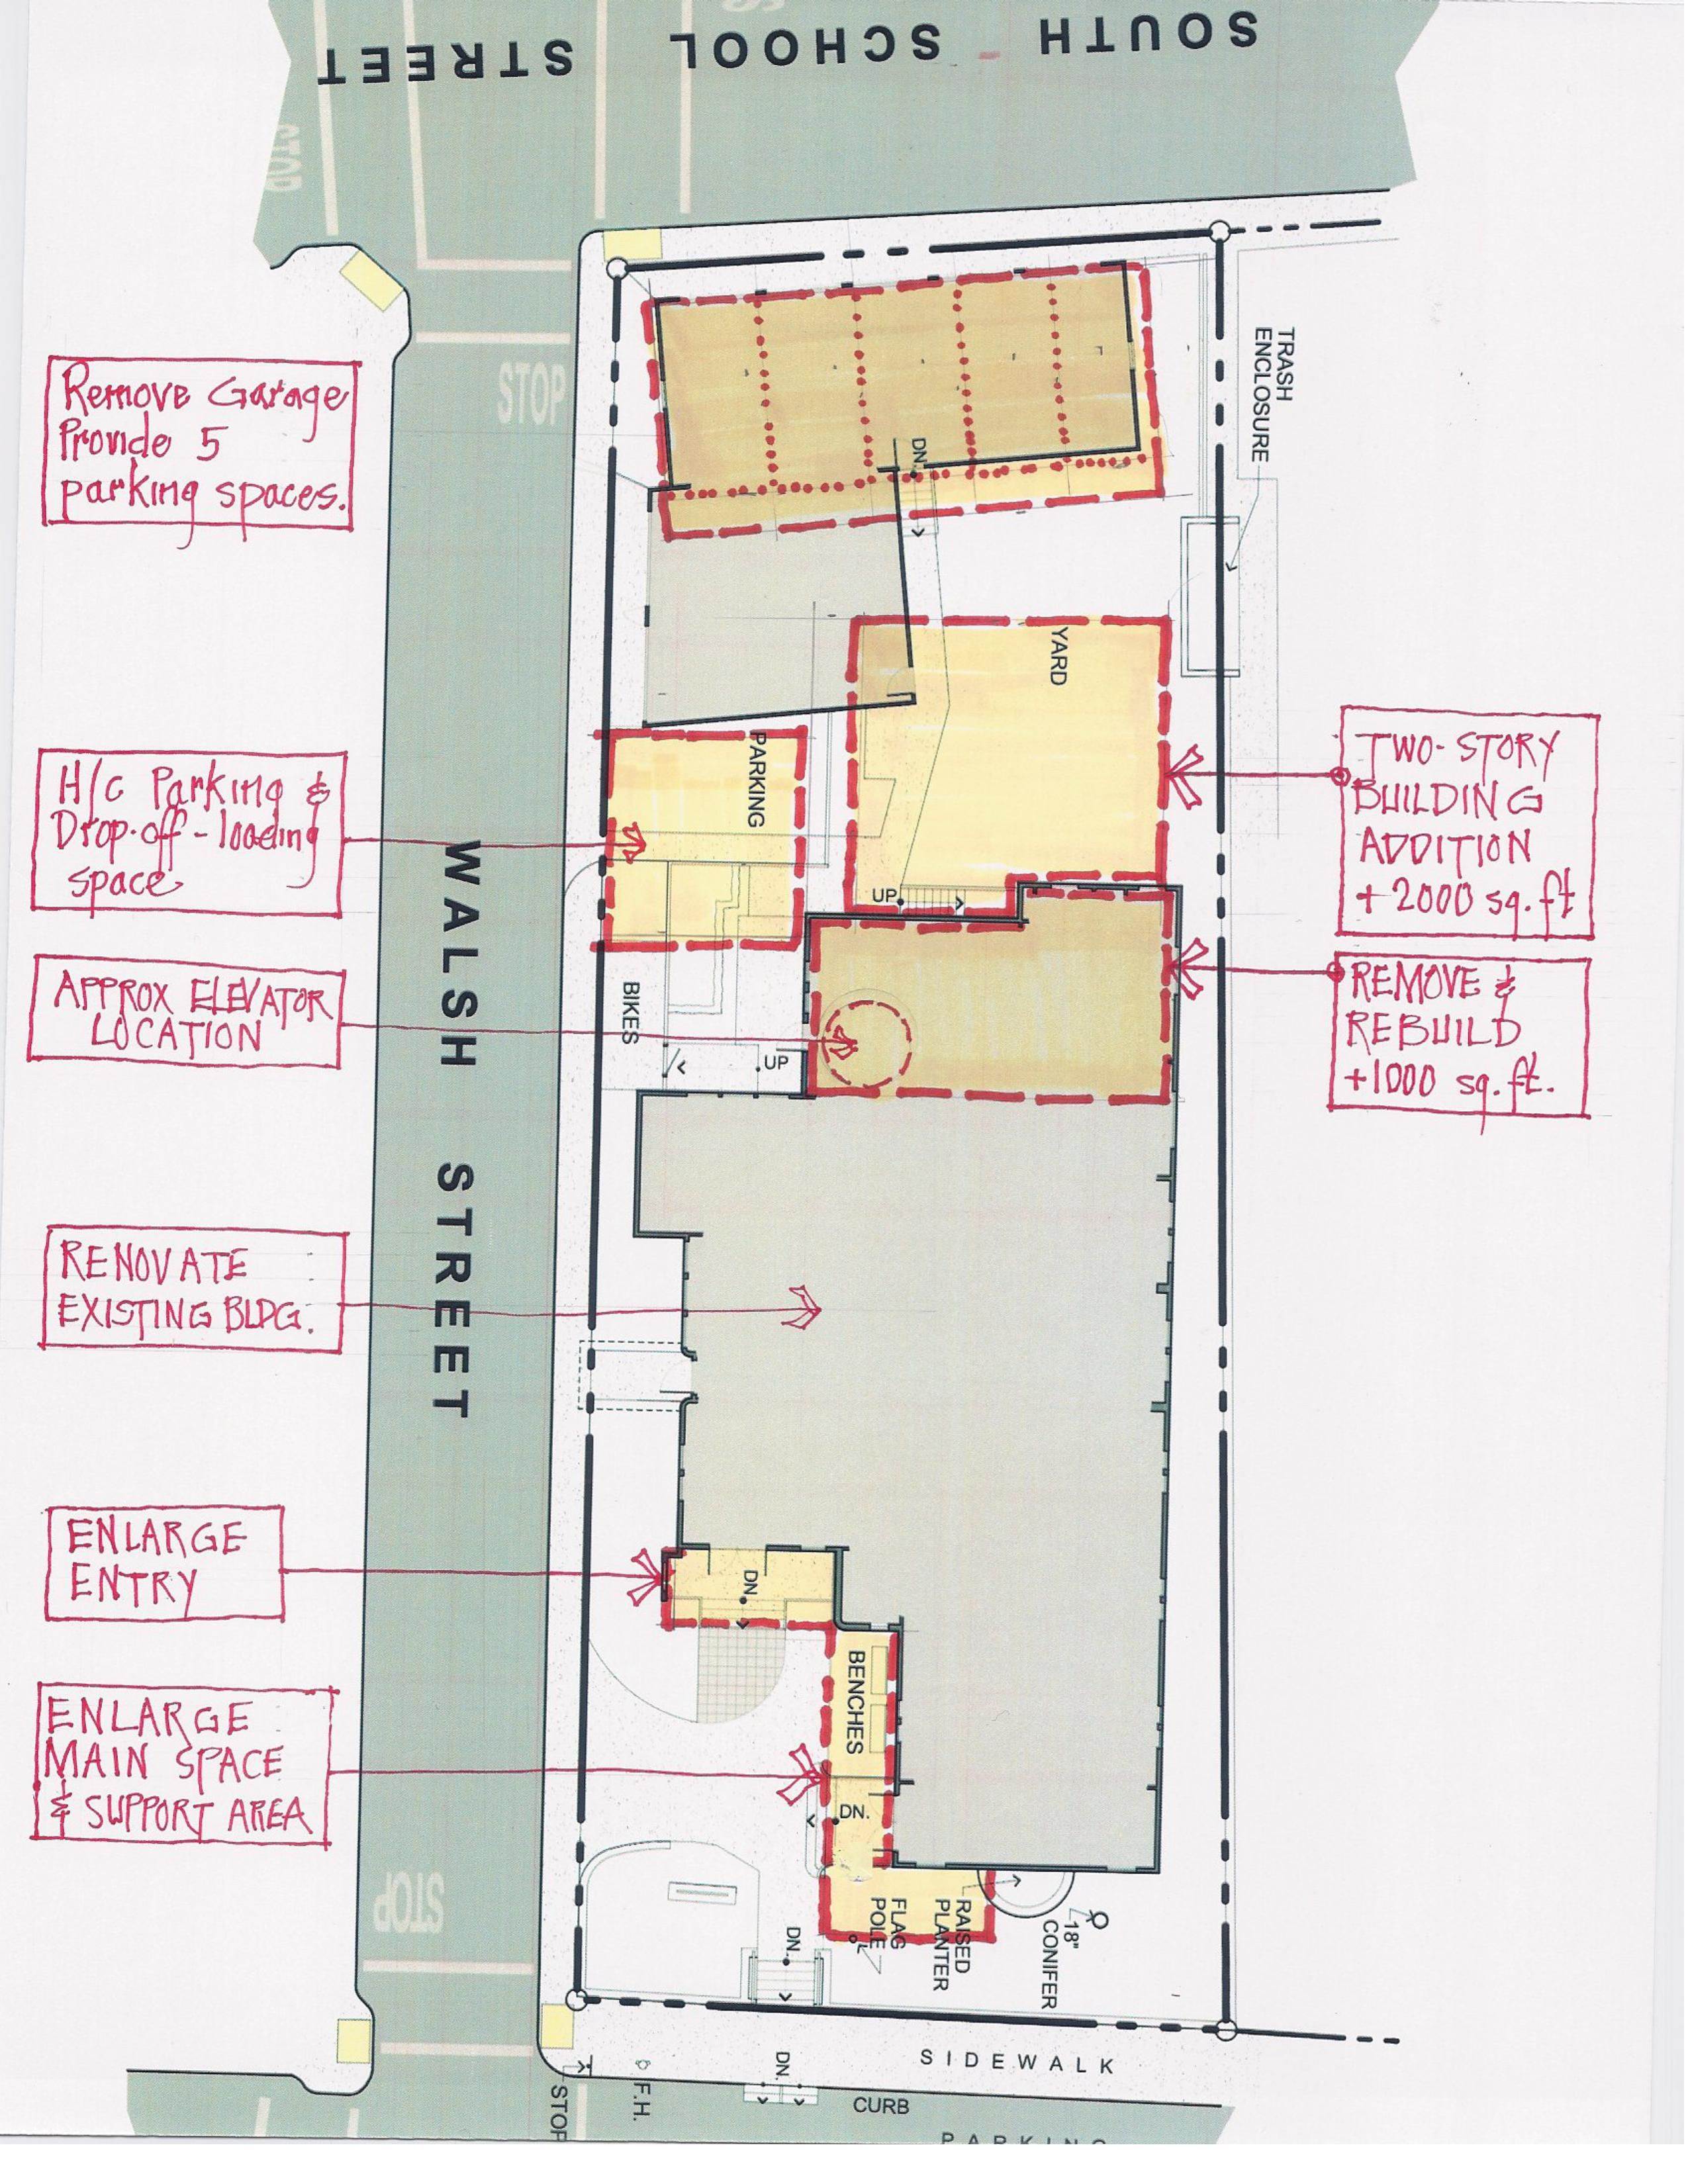
Concept site plan

Slide 14
Key issues for remodel
Some Key issues are ---
The building requires “full accessibility” with major expansion; this requires an elevator and new stairways for access to the second floor.
The building requires a fire sprinkler system if a major expansion (over 2,000 square feet) is undertaken.
Building expansion will require additional on-site parking spaces (using the upper garage/storage area) and an accessible parking space with accessible route to the entry door.

Slide 15
What else have we learned?
“Next Steps” Consultation
UUCM hired a UU consultant, Kay Crider, to help evaluate UUCM’s planning process for the future.
She met with leadership groups and made a presentation to the Congregation in March, 2022.
She provided a summary of findings:
1. UUCM could undertake a “facility Project” after further preparations and discussion amongst members – to discern and educate about the needs and wishes of the congregation, and to nurture a vision about our mission and goals.

Slide 16
More on Next Steps
Additional findings
  A capital campaign in the range of $750,000 - $1,000,000 could be undertaken, best to undergo in 2024
  The report summary acknowledges that a survey of UUCM members identifies “facilities/building” as the most important challenge to address in the next 5 years.

Slide 17
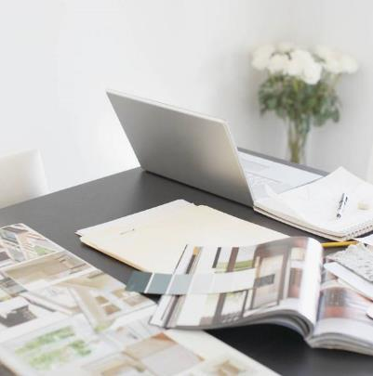
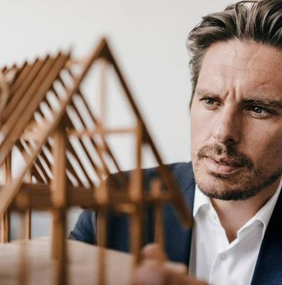
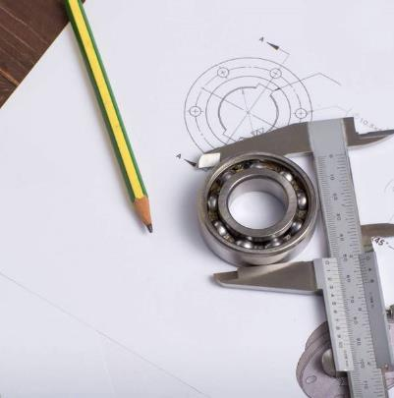

Thank you
Jeff Gold for the Facilities Exploration Committee

