Slide 1
UUCM
FACILITIES
EXPLORATION
WORKSHOP
January 7 2023
1:00 p.m.

Slide 2
What we'll cover in this MEETING
What we can do with our existing building
Visit to UU Davis
Other Options including the Church Next Door
Realtor Discussions
Finding the Money

Slide 3
DESIGN FOR OUR PRIORITIES
01.
Full building accessibility
02.
Improve "welcoming" nature
03.
Larger space for services and events
04.
More meeting rooms and offices

Slide 4
DESIGN FOR OUR PRIORITIES
05.
More space for family ministry
06.
More storage
07.
Enhanced outdoor spaces
08.
More parking close to building

Slide 5
O1. REMODEL FOR ACCESSIBILITY
  Eliminate steps and steep ramps.
  Add fully accessible entrance doors.
  Improve the staircase to the second floor.
  Add an elevator to the second floor.
  Provide accessible parking and drop-off area.
  Use "Accessibility Code Standards”.

Slide 6
O2. REMODEL FOR "WELCOMING"
  Enhance Landscaping
  More Natural Light
  Enlivening Colors
  "Green Building" Materials
  Improve Insulation
  Add Solar Panels

Slide 7
O3. ENLARGE FOR MORE SPACE
  Increase sanctuary seating to 100
  Increase size of entry foyer
  Increase # offices and meeting rooms
  Increase "family ministry" spaces
  Increase social hall and kitchen
  Increase storage

Slide 8
SPACE/ITEM | EXISTING SIZE: | PROPOSED: | CHANGE
SPACE/ITEM | [SQUARE FEET] | [EXPANSION PLAN] | % +
Foyer [excluding ramp & hallway area] | 170 | 300 | 75%
Sanctuary [including AV booth area & Dias] | 1,200 | 1,460 | 22%
Number of chairs/seats in Sanctuary | 80 | 100
Kitchen [including pantry] | 186 | 380 | 105%
Social Hall [after service space] | 380 | 540 | 42%
Library & Meeting Spaces [downstairs] | 200 | 430 | 115%
Office [downstairs] | 200 | 100 | -50%
Offices [upstairs] | 215 | 666 | 210%
Number of offices upstairs | 1 | 4
Multi-purpose meeting rooms [upstairs] | 500 | 638 | 27%
Family Ministry | 675 | 1,600 | 137%
Number of Family Ministry Space [both floors] | 3 | 5

Slide 9
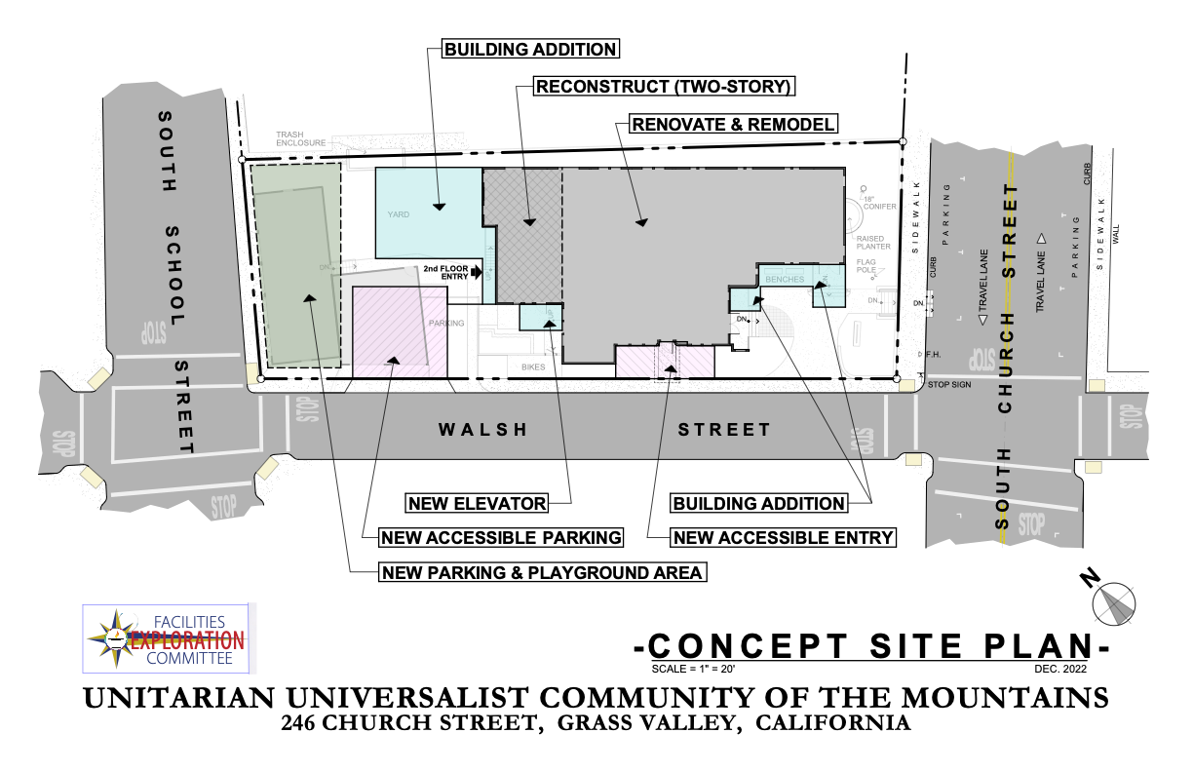

Slide 10
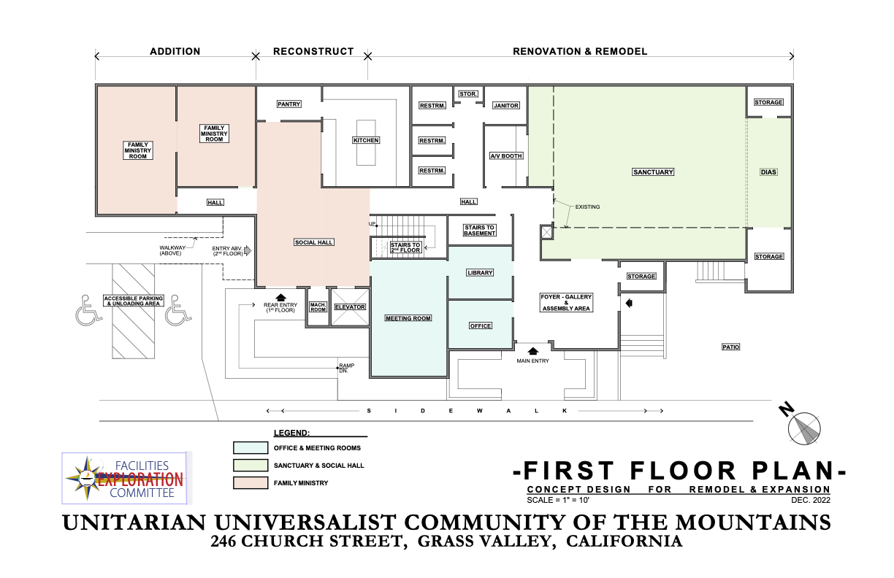

Slide 11
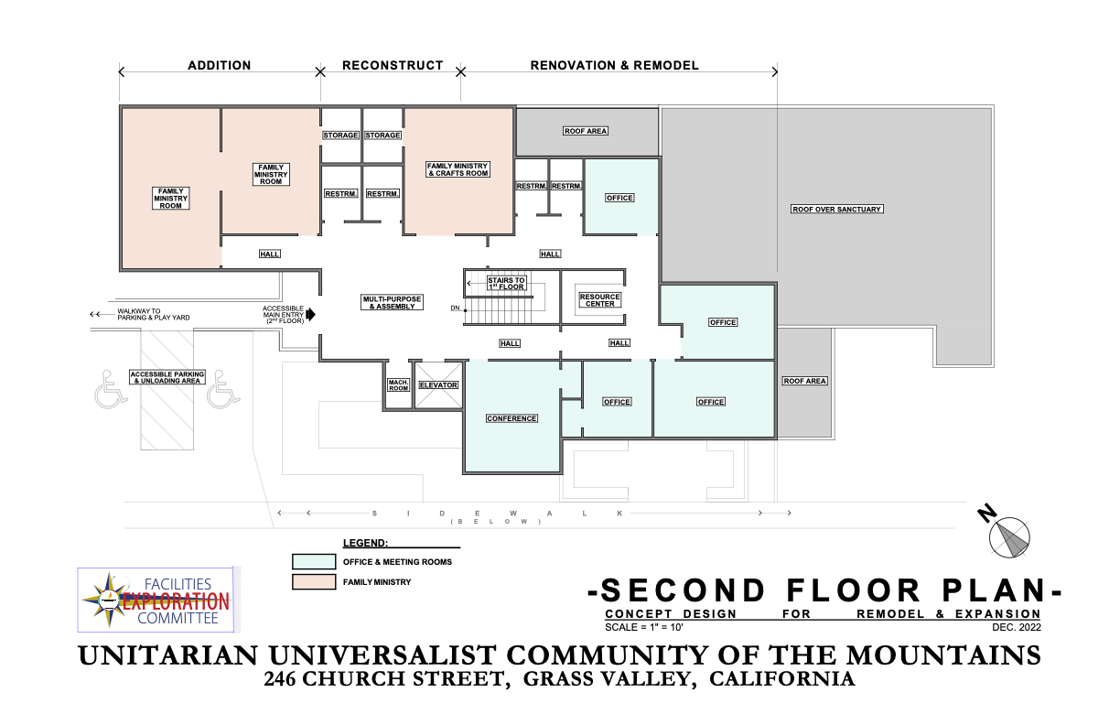

Slide 12
CHALLENGES &
SHORTCOMINGS
  Small Size of Property
  Site Constraints - Setback Lines
  Steep Slope
  Additional Costs - Elevator and Sprinklers
  Age of Building
  Configuration of Building
  Temporary quarters for a year

Slide 13
CONCLUSIONS
  Expensive - $1.5 million
  Elevator and Sprinklers - large part of budget
  Expansion CANNOT provide:
    Large enough sanctuary
    Space for full congregation
    Adequate parking and outdoor space
    Accessibility from public streets

Slide 14
RECOMMENDATIONS
  Existing building is not a long-term solution.
  Other options:
    Find and adapt a new location.
    Share space with Grass Valley UMC.
    Stay and adjust to what we have now.

Slide 15
QUESTIONS?

Slide 16
OTHER OPTIONS
  Buy a facility the size we need and remodel for us.
  Buy a larger space and rent to a non-profit for some income.
  Long-term lease, with or without option to buy
  Buy land and build.
  Share space – with GV UMC or another.

Slide 17
QUESTIONS?

Slide 18
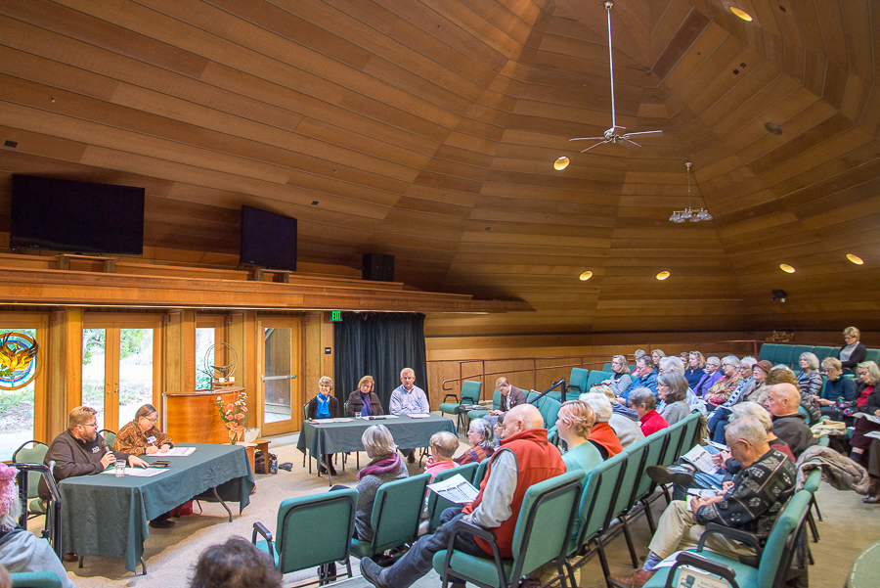
  Jeff Gold was the architect of major improvements.
  Property – 6 acres, purchased in 1966.
  Fully accessible, including exterior pathways and outdoor gathering space.
  Sanctuary seats 160 and can be opened to the social hall to add more.
  Ancillary buildings – library and office, classroom, gathering space for teens.
  More detailed report is available on request.
VISIT TO
UU DAVIS

Slide 19
QUESTIONS?

Slide 20
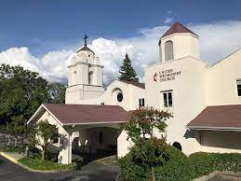
  Discussions have been good:
    Interest in sharing, either short or long term.
    Interest in possible sharing of efforts, perhaps in justice work.
    The Methodist denomination would be involved in any decision.
THE CHURCH NEXT DOOR

Slide 21
  The space is good:
    In addition to their sanctuary, there are two large assembly spaces and a number of office or classroom spaces.
    32 parking spaces.
    Flexibility would be required in scheduling services.
THE CHURCH NEXT DOOR

Slide 22
  Next Steps:
    Review their building plans to determine what space we would need to use.
    Consider operating and maintenance costs.
    Consider whether better suited to short of long-term sharing.
THE CHURCH NEXT DOOR

Slide 23
QUESTIONS?

Slide 24
REALTOR DISCUSSION
  Met with two firms. We evaluated them on:
    Experience in the area
    Working with nonprofits
    Pacing and knowledge of financing
  Reasons for choosing Blinder/ Tucker
    Competent and experienced
    Two people provide backup for each other
    Blinder was very “advisory” during the interview

Slide 25
REALTOR DISCUSSION
  Brought them up to speed on our process and our priorities.
    They’ll begin looking at properties shortly to help us know what may become available that could meet our needs.
    They will prepare an appraisal of the Church St property.
    They will regularly report to the FEC.
    No formal agreement was made.

Slide 26
QUESTIONS?

Slide 27
FINDING THE MONEY
  Our Consultant told us:
    We are a healthy congregation with strong members and experienced leaders.
    Typical congregations raise 3 to 5 times their annual giving for a capital project. For us, that would be between $750,000 and $1,250,000.
    This can only be accomplished if we develop a strong consensus about the path we will take.

Slide 28
FINDING THE MONEY
  A Capital Campaign could be combined with our annual Stewardship drive successfully.
  The highest priority is always to continue to give to our Annual Operating Funds.
  Generally, Capital Campaign pledges are payable over a 3-year period.
  A Capital Campaign is a once in a generation event, and gifts are often paid out of assets if available.

Slide 29
FINDING THE MONEY
  Value of the Church Street Property:
    Realtor estimates market value is $750,000.
    It would probably take 6 months to a year to properly market our property, if we decide to sell.

Slide 30
FINDING THE MONEY
  Possible Loans:
    If needed, a fairly small mortgage, much like the original mortgage on our current property, of around $250,000.
    Another potential source of funds would be bridge loans from members while the Church Street property is being marketed, to be repaid upon its sale.

Slide 31
QUESTIONS?

Slide 32
NEXT STEPS

